Slide 1

Welcome to Year 1
Notes:
Jumpers – Names
Recycling – Friday
Leaflet

Slide 2
Meet the Year 1 Team:
Conway Class
Teacher – Mrs Childs (Mon & Tues)
Teacher – Mrs Doyle (Thurs & Fri)
Ash Class
Teacher – Miss Licence
Teaching Assistants– Mrs Moule, Mrs Hagger, Miss Pun, Mrs Lembo & Mrs Sikora
Wednesday – Coach Ky, Mrs Bedford, Mrs Lembo, Mr Hopkins

Slide 3
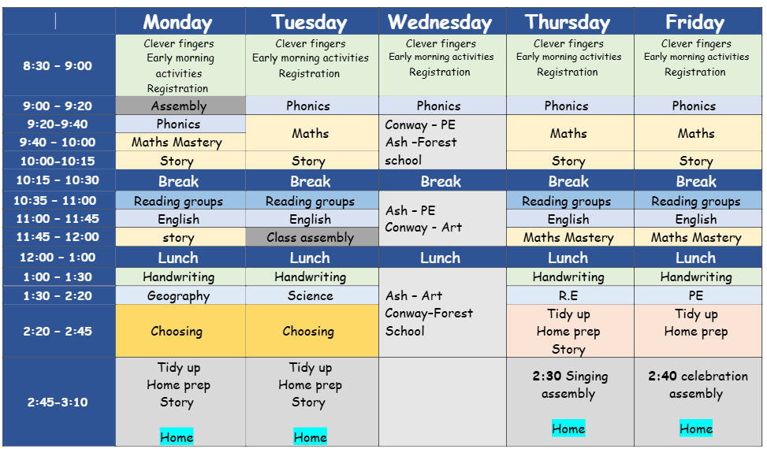
Our Timetable – Term 1

Slide 4

What do I need on a Wednesday?
Ash Class need to arrive wearing their PE kit and Forest School waterproofs, ready to start their session straight away. Children can arrive in normal footwear and then change into their wellington boots.
Conway Class need to arrive wearing their PE kit and their Forest School gear in a named bag ready for later in the day.
Regardless of the weather, children must have their legs and arms covered for Forest School to protect themselves.
Please come to school every day ready for whatever the weather. Children will need a raincoat with a hood as we tend to go outside in light rain.

Slide 5
Attendance and Punctuality
8:25am GATES OPEN
8:30am CLASS DOORS OPEN
8:40am GATES CLOSED, REGISTER IS TAKEN. CHILDREN ARE EXPECTED TO BE IN THE CLASSROOM AND SETTLED BY THIS TIME. LEARNING IS SET UP FOR THEM TO COMPLETE FROM 8:30am.
3:10am ACORNS ARE DISMISSED
If a child arrives to school after 8:40am, they must enter through the school office and they will be noted as LATE on the register.
If a child arrives after the register has been closed (8:50am), then this will be classed as an UNAUTHORISED ABSENCE (U code). 10 or more unauthorised absences within 10 school weeks may be subject to a Penalty Notice from KCC.

Slide 6

Our Term 1 Curriculum

Slide 7

Our Term 1 Curriculum

Slide 8

Home learning and how you can help at home
School Council entries
Numbots – KS1
Reading expectations
Children will receive their new reading book every Friday. The expectation is for them to read every evening for 15-20mins.
1. Decoding
2. Comprehending
3. Fluency
Reading records
Please record how many times your child has read. You can write a message or just sign the book to let us know that your child has read.
Phonics Homework Sheet
A sheet will be sent home every Friday with the sounds of the week. No need to send this back to us, please use it as a tool to practise at home.

Slide 9
Empowerment Approach
Persistent, consistent and insistent​
Protective measures to support all children​
Learning to be pro-social and think of others
Notes:
Persistent, consistent and insistent
Protective measures to support all children
Learning to be pro-social and think of others

Slide 10

Empowerment Approach
Notes:
Persistent, consistent and insistent
Protective measures to support all children
Learning to be pro-social and think of others

Slide 11




We also want children to embrace our school values – our 4Cs.

Slide 12
Communication
If you have any urgent messages to share with us, you can email the office and they will pass this on to us.
office@palacewood.kent.sch.uk
We will welcome the children every morning at the classroom door. Please encourage your child to walk down the slope to do the door on their own. This will allow us to focus on the wellbeing of the children coming into school and get them settled down inside. If you have a quick message you need to share with us, please write us a note and ask your child to hand it straight to us.
If you have any appointments, request of absence or medicine to hand in, this must all go through the school office in the Oaks building.

Slide 13
Questions?

