Slide 1






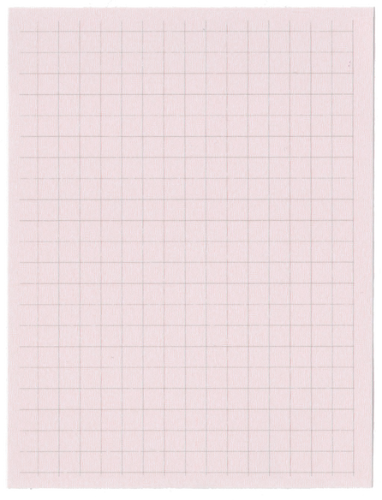
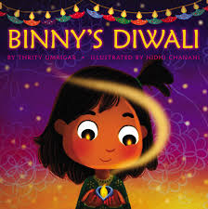

Year 1 Term 2
ENGLISH
KEY MESSAGES
MATHS
This term, we will enjoy reading exciting books in English. We will begin with Binny's Diwali.
We shall also be reading 'The Dot' before ending the term with some lovely winter poetry.
English will be structured into 45-minute lessons. Starting as a whole class on the carpet and followed by a task that will be teacher led or independent.
‘.
Our main focus this term will be the Year 1 winter performance at the end of the term. More information to follow on this ASAP.
Year 1 do not have forest school this term.
We will change books on FRIDAYS this term. Children must return their book on a weekly basis in order to receive the next book.
Regular reading and listening to stories is highly recommended and essential as this year your child will complete the statutory Year 1 Phonics Screening check in June. More information about this will follow this term.
Term 2 focuses heavily on place value and addition and subtraction including the use of part-whole models to support learning. We will also find out about 2D and 3D shapes this term.
Throughout Year 1, we will be teaching your child to count in 2’s, 5’s and 10’s. It would benefit your child if you supported them with this at home!
Term 2 texts

Slide 2

Year 1 Autumn/ Winter Term 2
HISTORY
In History, we will find out about life in the Victorian Era, who Queen Victoria was and the influence of Victorian Christmases on Modern day Christmas traditions.
DT
PSHE & RE
In Design and Technology, the children will explore puppets. We shall also be making decorations linked to our history unit of a Victorian Christmas.
In RE we will continue to focus on Christianity and find out about the Nativity story. Our PSHE focus is about keeping healthy and the importance of washing hands.
SCIENCE
PE
Science this term is all about Materials. Children will learn to differentiate between an object and the material it is made from. We will find out about the properties of everyday materials.
This term, PE will be on:
Monday and Thursday
Children are to arrive in school in their PE kit, please.
Please note: there is no forest school for year 1 in term 2.
PHONICS
COMPUTING
Add here
Following our end of term 1 assessments, the children will be grouped across the year group so their phonics teaching is matched to where they currently are on their phonics journey,
.
In computing we will begin to understand programming and algorithms.
MUSIC
Winter songs. Using our vocals and learning lyrics.

