Slide 1






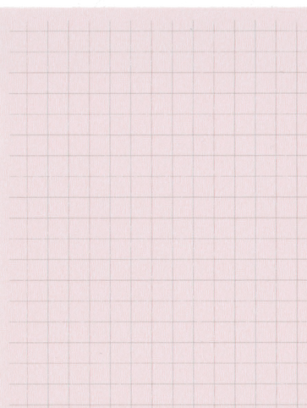


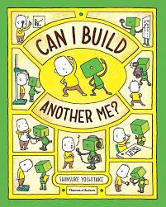

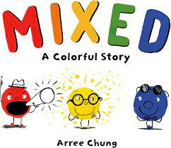
Year 1 Autumn Term 1
ENGLISH
KEY MESSAGES
This term, we will enjoy reading some wonderful books in English. We start with ‘Can I build another me’ by Sinsuki Yoshitake. The children will be able to tell us all about themselves using the examples in the book.
English will be structured into 45 minute lessons. Starting as a whole class on the carpet and followed by a task that will be teacher led or independent.
‘Mixed’ and ‘The Perfect Fit’ are the other books we will cover this term.
MATHS
Welcome to Year 1. We look forward to an exciting term ahead and getting to know you all.
The children will start bringing two books home every Friday, a reading for pleasure book from our book corner and a decodable phonics book. Book change day will then continue to be every Friday for this term. Children must return their book on a weekly basis in order to receive the next book.
Regular reading and listening to stories is highly recommended as this year your child will complete the statutory Year 1 Phonics Screening check in June. More information about this will follow soon.
Term 1 starts by looking at pattern and sequencing in Maths.
Throughout Year 1, we will be teaching your child to count in 2’s, 5’s and 10’s. It would benefit your child if you supported them with this at home!
Term 1 texts

Slide 2





Year 1 Autumn Term 1
GEOGRAPHY
In Geography, we will be learning about our school, including the immediate surrounding areas.
ART
PSHE & RE
This term the children will attend Art lessons with Mrs Bedford in the new Art room. The focus will be Spiral art.
In RE we will begin learning about Christianity including God, Christian traditions and celebrations.
SCIENCE
PE
Science this term is Animals. We will be naming and grouping animals.
PE
Wednesday – Tennis with Coach Ky
Friday – Ball Skills Mrs Doyle and Miss License
Wednesday – Forest School
PHONICS
COMPUTING
Add here
Children will receive two phonics lessons a day. The first will be a whole class lesson, followed later in the day by grouped reading and phonics
.
In computing we will begin to explore the basic functions of a laptop and how to log in
MUSIC
Pulse and rhythm. Children will be listening and clapping to beats.

