Slide 1







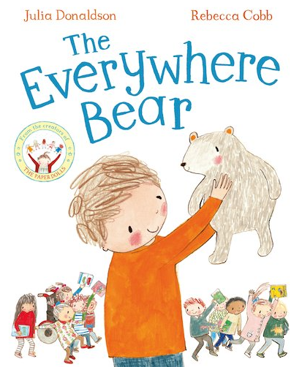
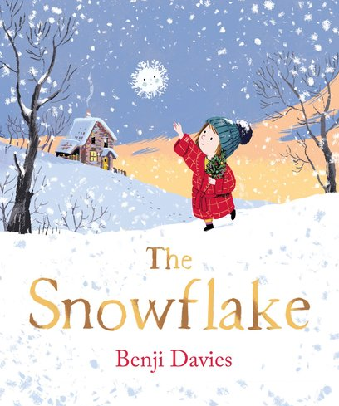

EYFS Spring Term 3
LEARNING
KEY MESSAGES
Our theme for this term is “Journeys”. Through this theme we will be learning about winter and the changes this season brings. Along with different types of past and present transport, maps and road safety. We will be putting this learning into action by going for a walk in our local area. We will end the term by learning all about space!
LEARNING
Welcome to Term 3 in EYFS! We hope you are all well rested after the Christmas break.
Please continue to ensure your children come to school with suitable clothing for the cold weather, with plenty of layers. As always, please also ensure everything that is brought into school is clearly named, including shoes.
This term we will be continuing to support the children’s growing independence with tasks such as putting on their own coats, shoes and wellies, and doing up zips. Please encourage your child to “have a go” with these tasks at home too. ☺
This term, we will be using a variety of texts to support our learning. These texts include “The Snowflake”, “The Everywhere Bear” and “Pirates Love Underpants”. We will also be reading winter poems.
We will be learning how to write simple sentences.
Term 3 texts

Slide 2

EYFS Spring Term 3
P.E.
LEARNING
P.E. day for both classes is Wednesday. Please ensure earrings are removed for P.E.
REMINDERS
If you have not already done so, please make sure your child has waterproof separates in school.
Any messages or reading comments should be recorded in your child’s reading record please. Your child’s “zippy wallet” will be used for any correspondence between home and school.
Reading records are taken in on THURSDAY evenings, so they can be checked ready for book change on Friday.
Please ensure all books are returned on a Friday.
LEARNING
In maths this term, we will be consolidating our counting skills, counting to larger numbers and developing a
wider range of counting strategies.
As part of our learning about winter we will be exploring different natural world environments with our senses.
We will be taking a journey through space and time by looking at pictures of old and new transport and talking about the differences we notice.
This will also include naming and describing figures from the past.
HOME LEARNING
PHONICS
All children will continue to bring home a “sharing” book each week, for you to read with or to your child, as well as either a wordless book or a Read, Write Inc. phonics book for them to read to you.
This term we will continue in our phonics groups. If your child brings home a Read, Write Inc book, they will have practiced this book throughout the week at school. As it is a book that is familiar to them, they might be able to read it at home with increased fluency.

