Slide 1





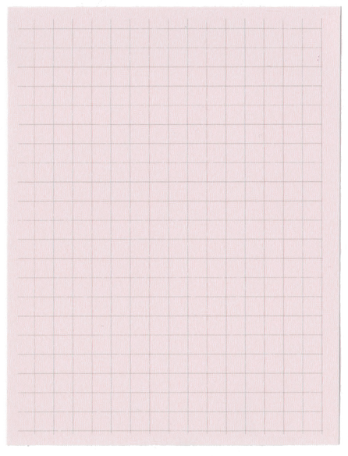
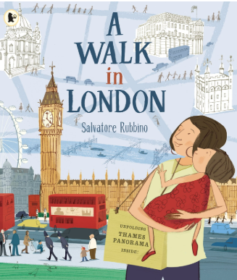

Year 1 Spring Term 3
ENGLISH
KEY MESSAGES
At the start of the term, we will be thinking about navigation and look at London in the story ‘A Walk in London’. We will immerse ourselves into the story by walking around the school grounds to find the London landmarks.
We will then study the book ‘Astro Girl’ by Ken Wilson-Max and take ourselves on a journey through Space.
MATHS
This term we will look further at numbers to 20. This will include understanding the place value, doubles and near doubles, addition and subtraction as well as number bonds. We will be estimating using a number line to 20. At the end of this term, we will extend this learning to numbers beyond 20.
We would like to welcome you back to Year 1, hoping that you all had a wonderful Christmas break. This term we will be pushing forward with phonics, groupings will be changed to meet your child’s ability and support will be put in place to help those finding it tricky. To support your child at home, please continue read regularly and complete the weekly phonics homework. Home reading must be recorded and zippy wallets in bags daily. We will change books on Thursdays.
Term 3 texts

Slide 2
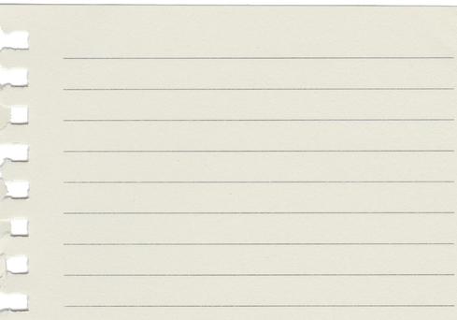
Year 1 Spring Term 3
COMPUTING
In computing, we will be using the different keys on a laptop keyboard to type, including space bar, back space and enter.
ART
HISTORY
We will be very lucky to have Mrs Bedford and Mrs Lembo back again for Art every Wednesday!
As our theme this term is ‘navigation’, we will be learning about the journey Florence Nightingale took to become a nurse and the impact she had on our lives today.
PE
Our PE days will be on Mondays and Tuesdays.
SCIENCE
RE & PSHE
MUSIC
In Science we will focus on parts of the Human Body. We will explore our 5 senses and how they help us to understand our environment.
In RE, we will explore sacred places for Jewish and Christian people.
In PSHE, we will look at what makes a healthy relationship.
During music, we will listen to and following a melody on the glockenspiel.
Add here
Forest School
Forest School will run in small groups every Wednesday.

