Slide 1





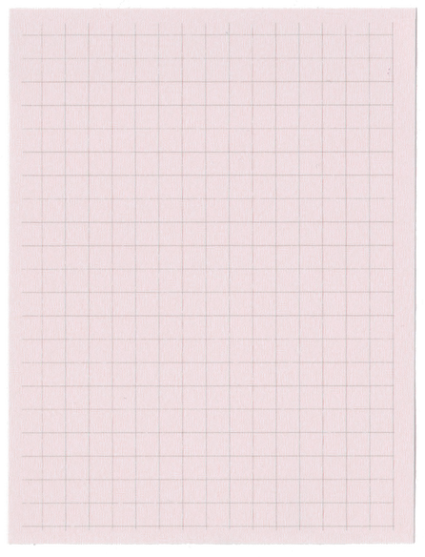





Year 1 Spring Term 4
ENGLISH
KEY MESSAGES
In English, we will begin the term by using our whole-school text, Mel Fell, to retell the story.
We will then explore the theme of sustainability through three exciting texts. During this unit, the children will learn the features of letter writing, how to write a clear set of instructions, and how to create their own fact file.
The key skills we will focus on include using conjunctions, using modal (bossy) verbs, adding adjectives to describe, and developing our understanding of punctuation, including question marks and exclamation marks.
MATHS
This term, there will be a real focus on reading and phonics. The children will be regrouped to best match their current ability, and extra support will be provided for those who need it.
Reading at home regularly is incredibly important. It has a huge impact on children’s fluency, blending, word recognition, confidence, and their long-term love of reading. Please make sure all home reading is recorded, as this allows us to celebrate your child’s efforts in school by awarding reading bands. Please ensure that zippy wallets are in your child’s bag every day. Reading books will be changed on Thursdays, and homework will be sent home on Fridays.
This term in Maths, we will be developing our understanding of numbers to 50. The children will explore place value, doubles and near doubles, addition and subtraction, and number bonds. They will also practise estimating and placing numbers accurately on a number line to 50.
Towards the end of the term, we will begin learning about length and mass.
To help your child build fluency with number bonds, we recommend using
NumBots and
Hit the Button at home.
Term 4 texts

Slide 2

Year 1 Spring Term 4
COMPUTING
DT
We will learn that algorithms are sets of instructions. The children will follow and give simple step-by-step instructions, using directional and ordering language correctly. .
Geography
We will design and make a moving vehicle using recycled materials, linking to our sustainability theme of reduce, reuse, recycle.
We will explore our local area, Allington and Kent, using locational language and developing map skills. The children will create their own maps to showcase their learning.
PE
Our PE days will be on Thursday and Friday.
RE & PSHE
MUSIC
SCIENCE
Our big question is How should we care for the world? We will explore this through learning about what different faiths believe about caring for the world.
In PSHE, we will focus on being responsible, recognising potential dangers, and learning how to keep ourselves safe.
Add here
The children will develop their understanding of dynamics, singing, and keeping rhythm and harmony.
We will learn about everyday materials in the context of recycling, building on prior knowledge. The children will explore which materials are suitable for different purposes, where they come from, and how they should be disposed of responsibly.

