Slide 1
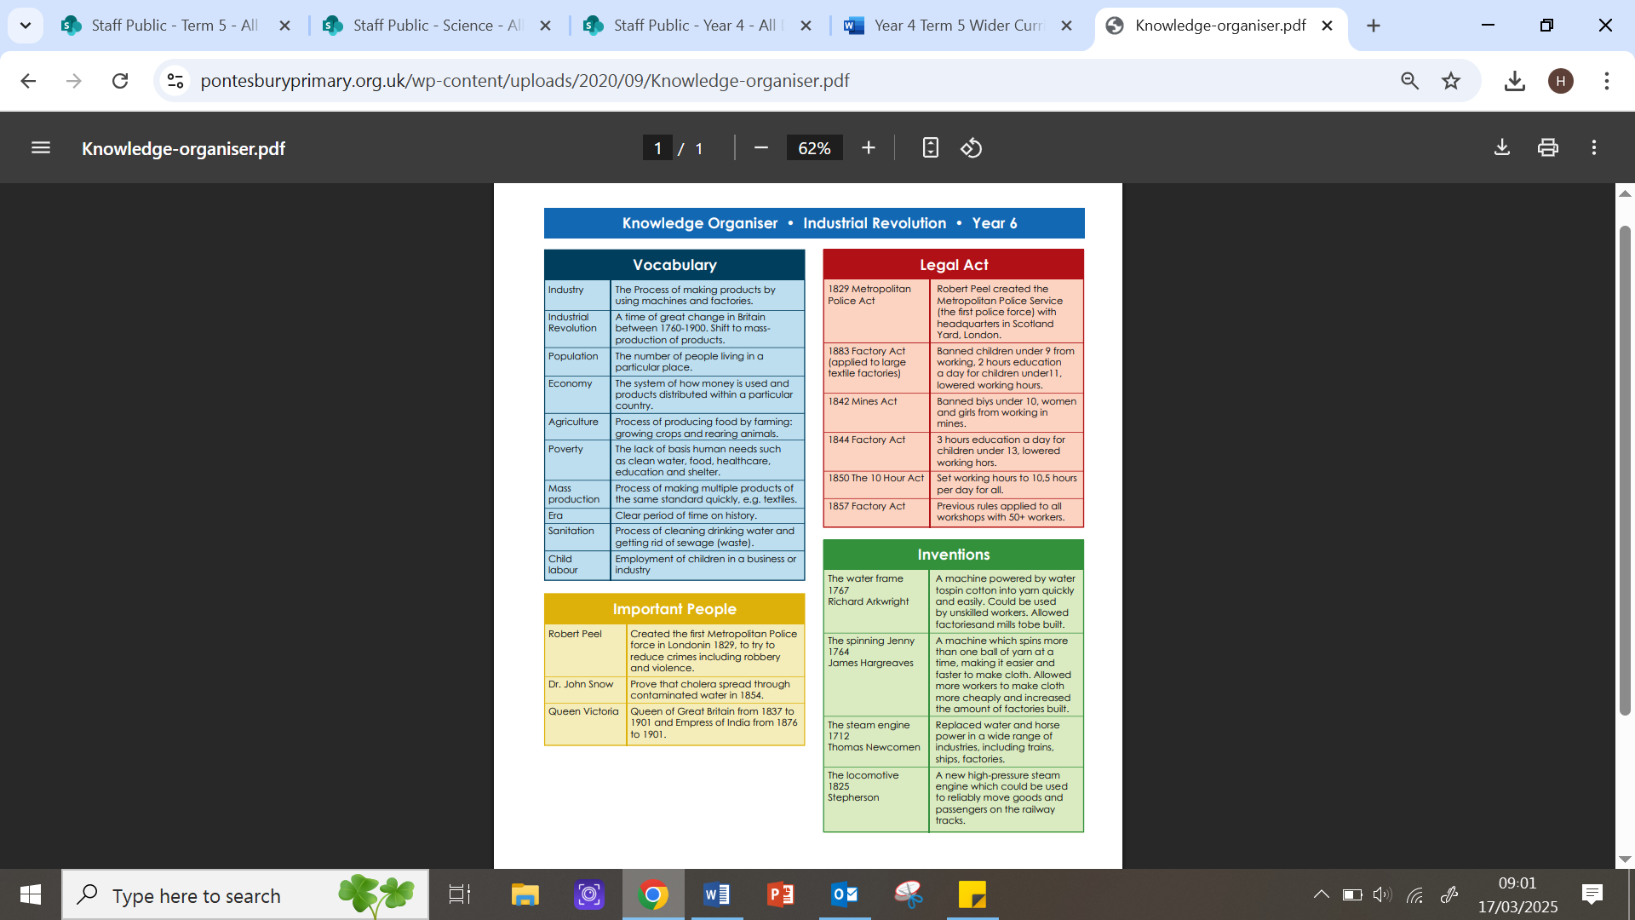
TERM 5:
Unit: Industrial Revolution | Vocabulary Needed: industry, population, economy, agriculture, poverty, mass production, era, sanitation
KEY LEARNING OBJECTIVES:
I can understand what the Industrial Revolution was. I can explain key inventions and their impact. I can understand how the Industrial Revolution changed people’s lives. I can understand social classes. I can explain how the Industrial Revolution ended.

