Slide 1

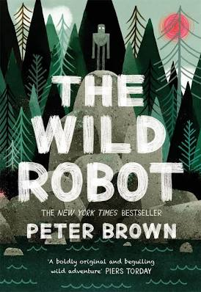
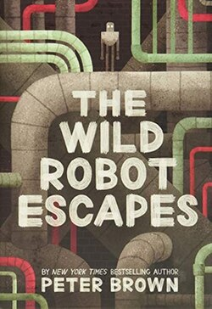
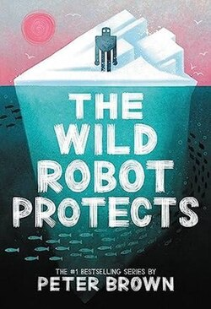


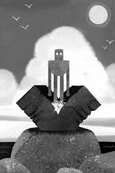

Year 2 – Term 6 – Book Warmer
‘The Wild Robot’– By Peter Brown
Here are some more of ‘The Wild Robot’ stories:
When robot Roz opens her eyes for the first time, she discovers that she is alone on a remote, wild island. She has no idea how she got there or what her purpose is – but she knows she needs to survive. But as Roz slowly befriends the animals, the island starts to feel like home – until, one day, her mysterious past comes back to haunt her.
At the start of the story, only 5 crates from a cargo ship remain, floating in the ocean.
Each crate contains a robot.
Can you design your own robot and the island it would live on?
Use adjectives to help you describe.
Roz slowly befriends the animals on the island. Can you find out what ‘befriends’ means?
Our theme this term:
Health
Challenge!
Have a look at the front cover of the book.
Can you make a prediction about what this story will be about, using the title and front cover of the book?

