Slide 1






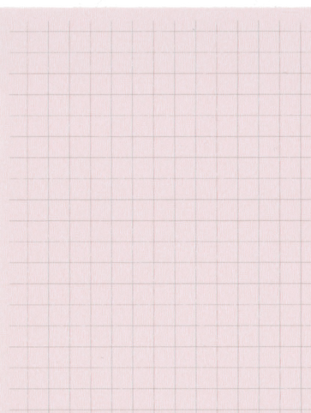

Year 2 Summer Term 6
ENGLISH
KEY MESSAGES
Our English text this term will be “The Wild Robot” by Peter Brown. Through this text we will be exploring the our 4C themes of compassion, courage, challenge and curiosity.
We will use descriptive language to describe the setting and characters. We will then use the story as a guide for writing our own adventure stories. Towards the end of the term we will be learning about communicating through writing letters.
In novel study, we will be focusing on the vocabulary used in the text and the author’s choices.
MATHS
Welcome to term 6 in year 2!
It is hard to believe we are reaching the end of the school year, and your child’s time in Key Stage 1!
As the warmer weather continues, please ensure your child brings their water bottle and a sun hat every day, and has had sun cream applied. If bringing in sun cream from home, please ensure this can be applied independently, and that it is named.
Our whole school theme for this term is “Health”, learning about how to keep our minds and bodies healthy.
We will also be thinking about the transition to KS2 and supporting the children through this time.
In maths we will begin the term by learning how to measure mass and temperature. We will then move onto fractions: finding halves, quarters and thirds of shapes and numbers. We will also be learning about time.
Term 6 text

Slide 2

Summer Term 6
Computing
History
PSHE and RE
In Computing this term, we will be learning how to create music digitally.
This term in History we will be comparing the Ancient Olympics to modern day Olympics. We will be looking at artefacts and thinking about what has stayed the same and what has changed over time.
In PSHE we will be thinking about online safety and healthy eating.
In RE, we will be considering the question “What makes some places sacred?”.
PE
PE this term will focus on athletics and orienteering.
PE days for both classes will be on Mondays and Tuesdays.
Music
DT
Science
Our science focus for term 6 is animals including humans. We will be learning about the stages of human growth and creating a timeline. We will be talking about life cycles and what animals need to survive.
This term in DT we will be sewing! We will be designing and creating our own flags, using a running stitch. We will then evaluate what went well and what we could improve.
In music, we will be listening to different pieces, comparing them and thinking about how they make us feel. We will then move on to composing music in small groups.
Home Learning
Zippy wallets will be collected in on a THURSDAY to be checked. Books may be changed any day, once they are finished.
Please remember to complete TTRS and EdShed regularly to support learning.
Add here

